Slide 1
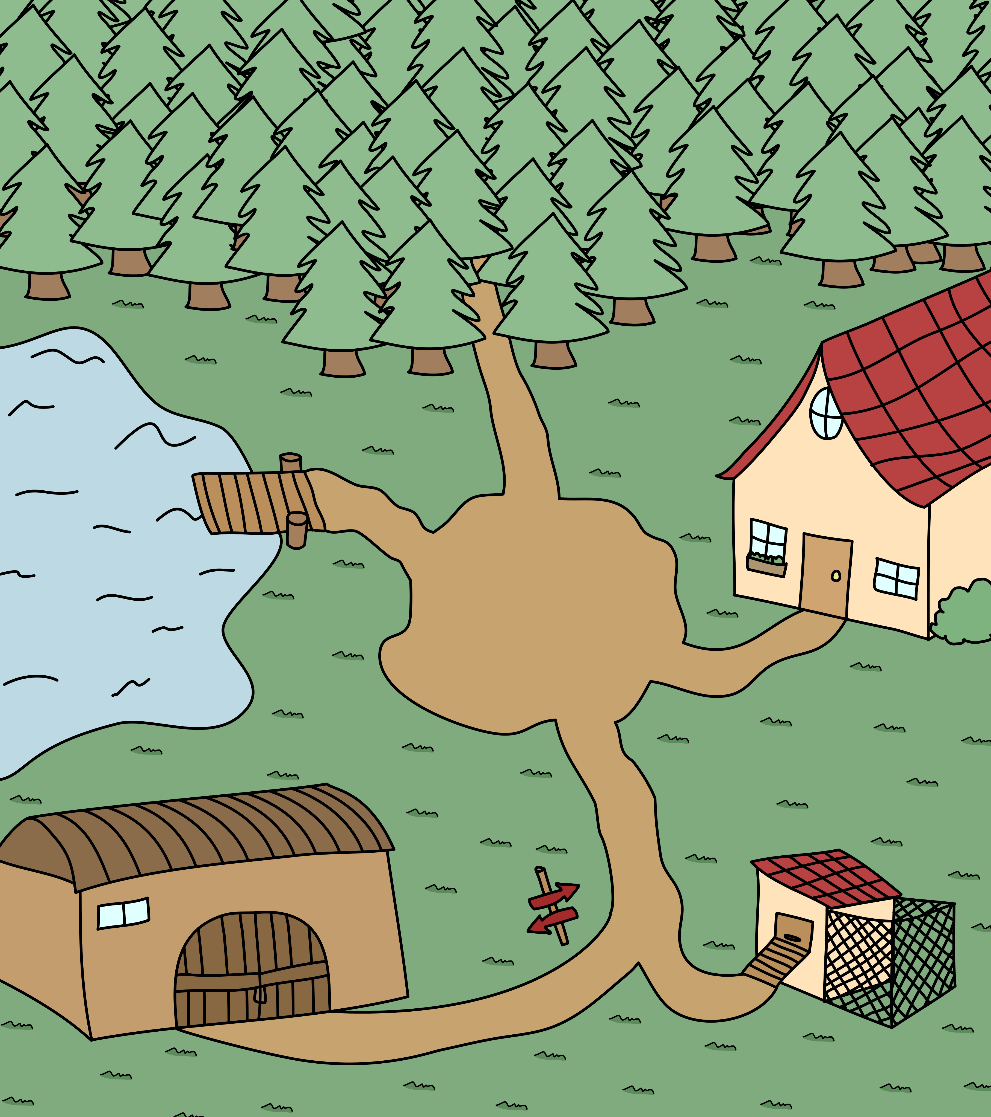


Slide 2



Slide 7


Slide 10
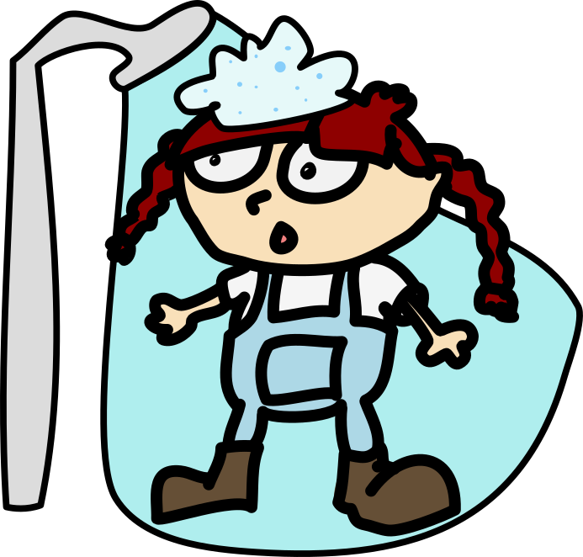

Slide 13


Slide 16


Slide 19
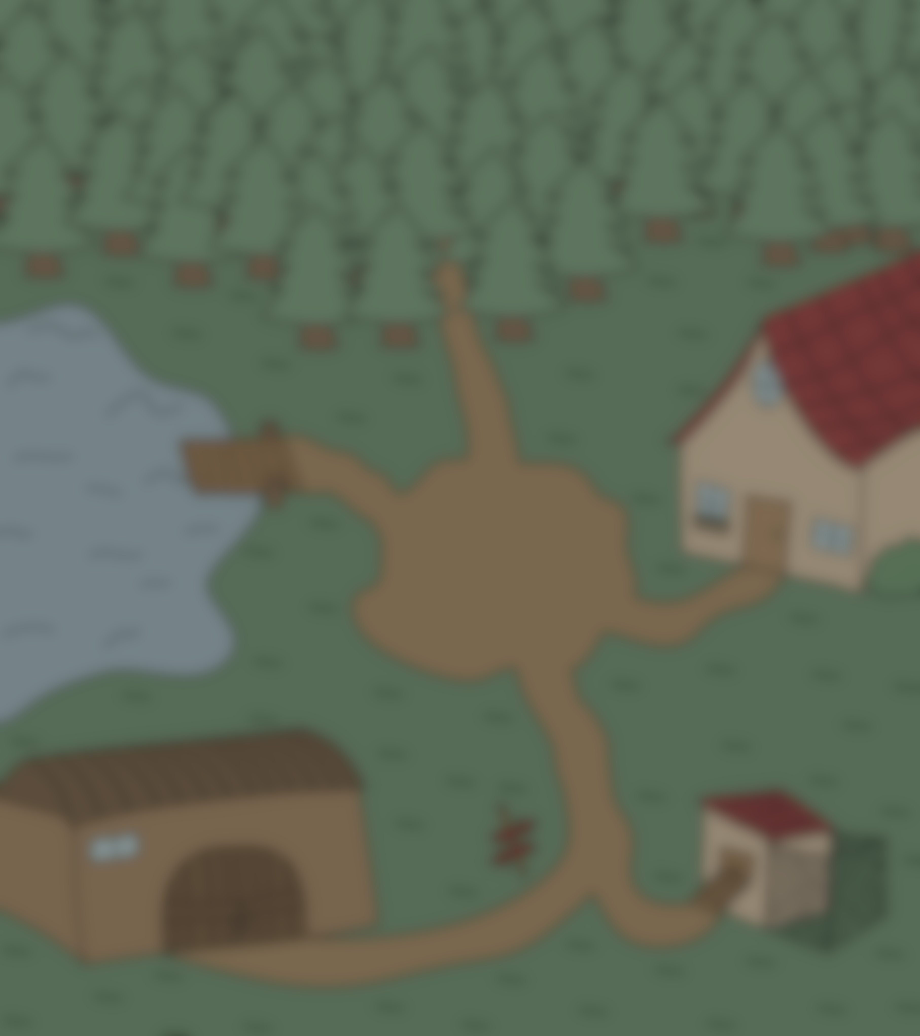
YOU WON
CONGRATULATIONS!

